Slide 1
Car Price Prediction
Prepared By:
Dishant Doshi

Slide 2
Problem Statement
With the covid 19 impact in the market, we have seen lot of changes in the car market. Now some cars are in demand hence making them costly and some are not in demand hence cheaper. One of our clients works with small traders, who sell used cars. With the change in market due to covid 19 impact, our client is facing problems with their previous car price valuation machine learning models. So, they are looking for new machine learning models from new data. We have to make car price valuation model. This project contains two phase

Slide 3
Project Planning
Data Collection by Web Scrapping
Data Analysis(EDA)
Data Pre-processing
Data Cleaning
Model Building
Model Evaluation
Model Selection

Slide 4
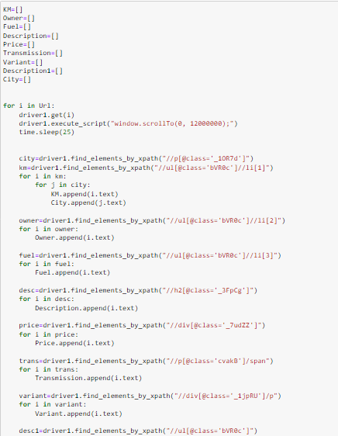
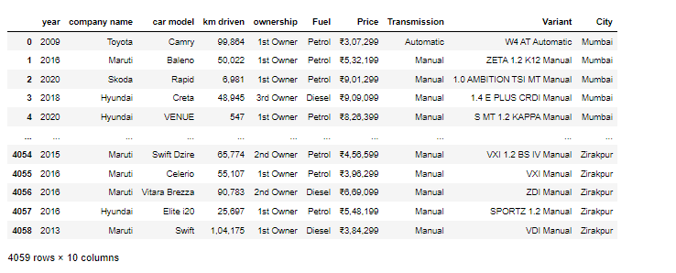
Web Scrapping
Here In Above picture in left side we can see the code of web scrapping and in right we see
The dataset which we scrapped form the Car24.

Slide 5
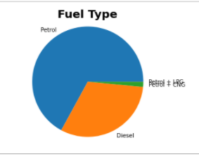
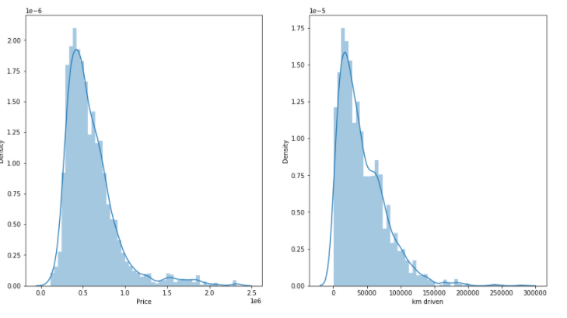
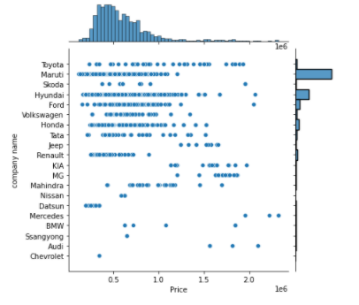
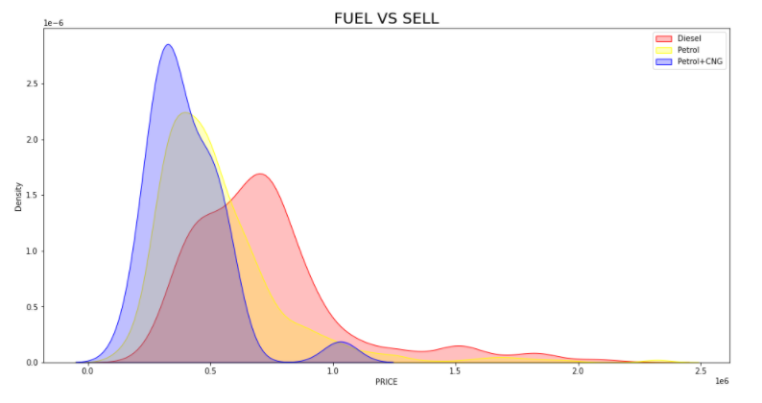
EDA(Visualisation)

Slide 6
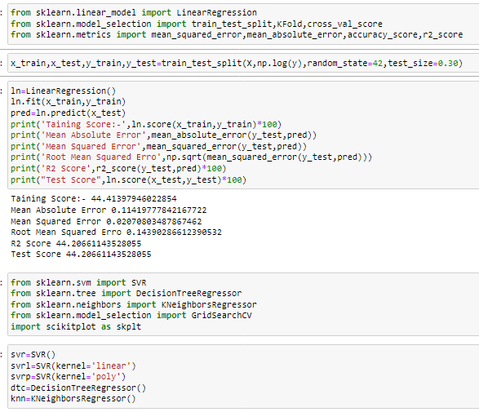
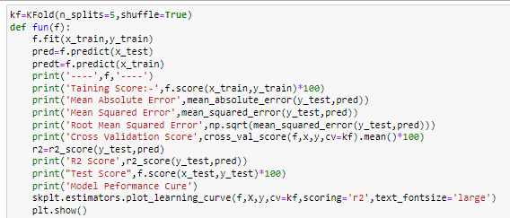
Model Building
Here We Create one function that will give return of RMSE,Accuracy Score,R2 score , cv score

Slide 7
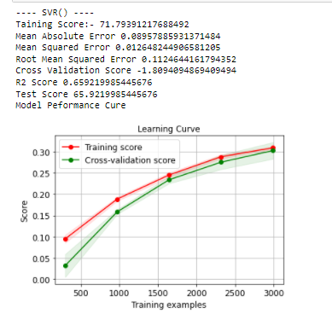
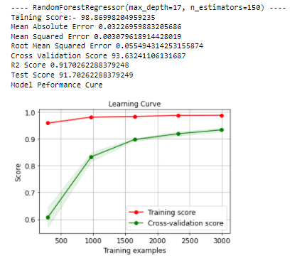
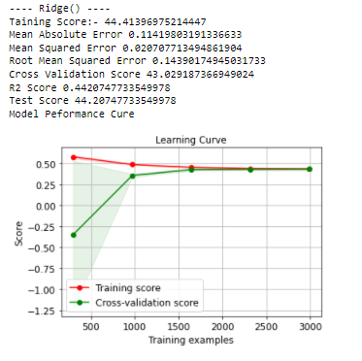
Performance Curve

Slide 8
From this table we can see the Random Forest is fit for model selection.

Slide 9
THANK YOU

